Slide 1
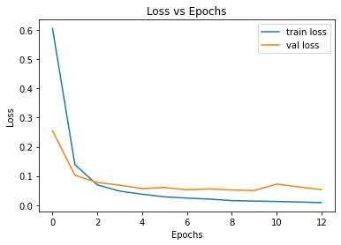
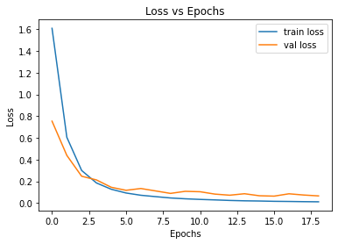
Ethan Masters
AI Subsystem Demo
Training Loss Curve Comparison
Base Model
After Demo Training

Slide 2
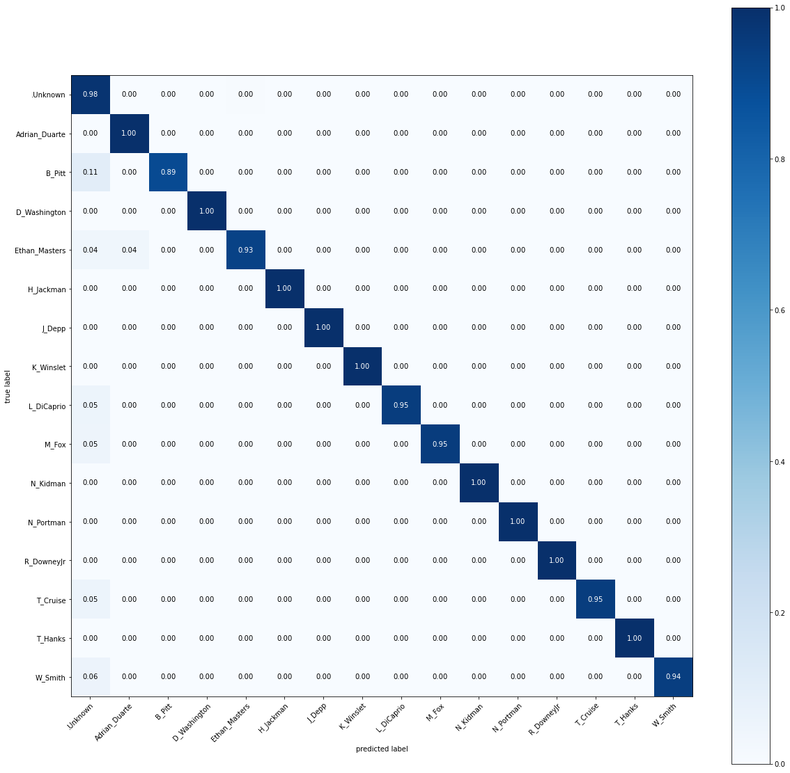
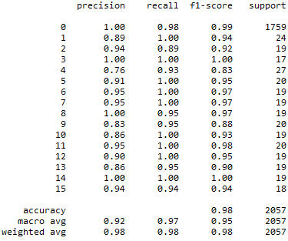
Base Model
Confusion Matrix
Base Model Confusion Matrix
Statistics
Precision:
Recall:
Accuracy:
F1:
98%
98%
98%
98%

Slide 3

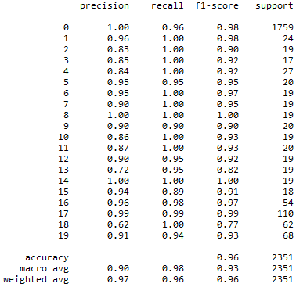
Demo Trained Model
Confusion Matrix
Demo Confusion Matrix
Statistics
Precision:
Recall:
Accuracy:
F1:
97%
96%
96%
96%

Slide 4
New Classes Confusion Matrix
Correctly recognized the new classes with a success rate of over 90%, the minimum required by our FSR.

